Slide 1
Lab 3: A Foodie’s Dilemma
STAT 201: Elementary Statistics

Slide 2
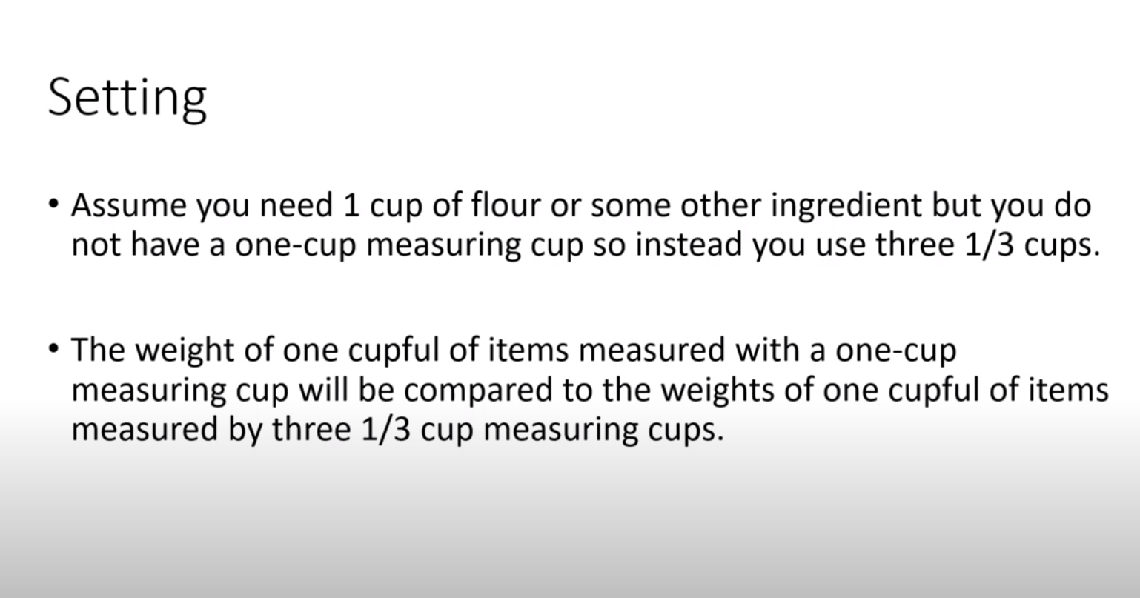

Slide 3
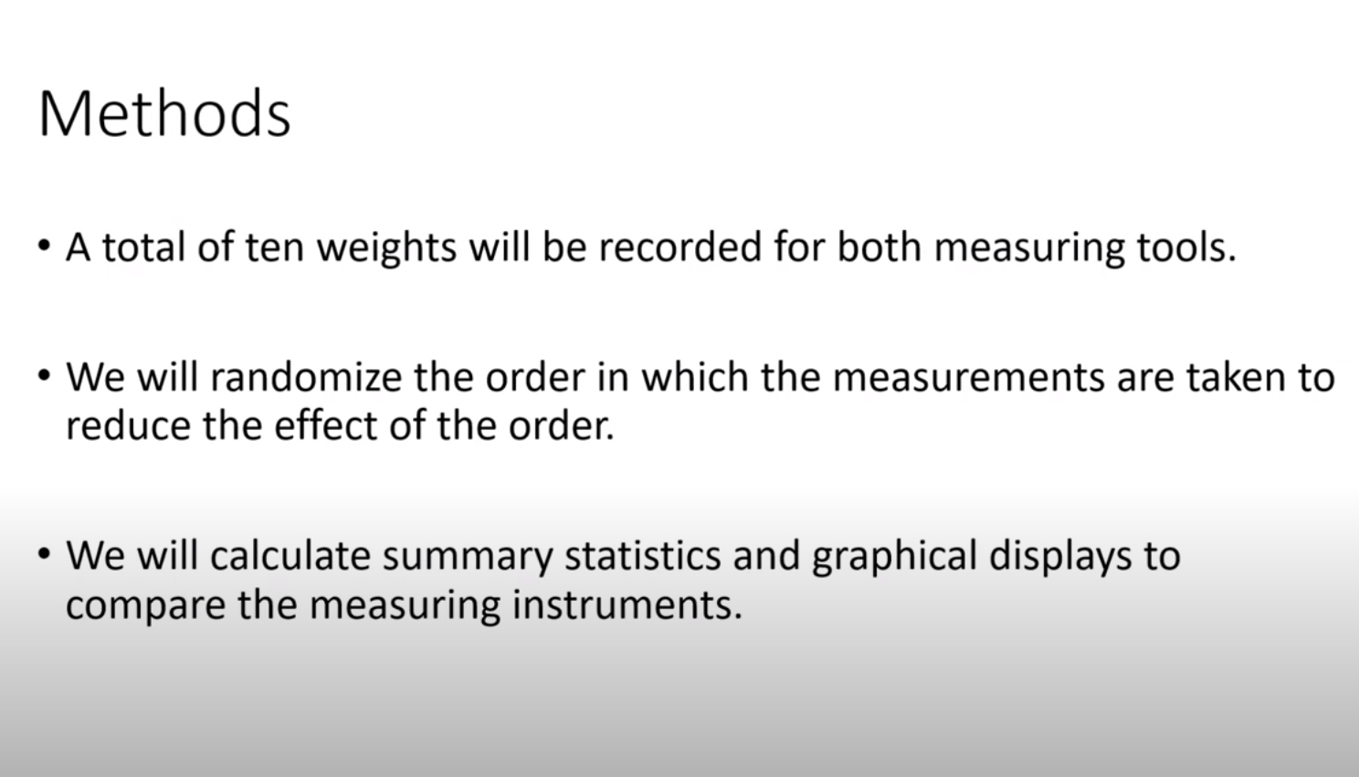

Slide 4
Step 1: Randomize the Order
Steps in StatCrunch: https://www.statcrunch.com/
In VAR1 column 1 => type FIRST 10 times (rows 1 to 10 should have FIRST ). Type SECOND 10 times (rows 11 to 20 should have SECOND).
Data -> Sample ->
Select columns: var 1 (the column you just created)
Sample size: 20
Make sure you do not select “Sample with replacement”
Click Compute
Fill in the 3rd column called “Random Number Sorted” of the Table 3.2.
Fill in the 2nd column called “Variable” of the Table 3.3.

Slide 5
Step 2: Using the order in table 3.3 start measuring.
Have your two measuring tools ready and measure in unit CM (centimeter). Denote one as FIRST (for example, a small ruler) and the other as SECOND ( for example, a measuring tape)
If the first variable in your randomized sequence is ….
FIRST then use your FIRST measuring tool to measure the length of the 1st spoon and record measurement.
SECOND then use your SECOND measuring tool to measure the length of the 1st spoon and record measurement and so on.
Measure all 10 spoons using your First and Second tool according to the random order. You will have 20 measurements at the end.
- Do not do all FIRST measuring measurements at once (or vice versa).
Put all the measurements in the 3rd column of the Table 3.3.

Slide 6
Step 3: Calculations by Hand
NOTE THAT YOU DO ONE SET OF CALCULATIONS FOR THE VALUES WITH FIRST AND ANOTHER/SEPARATE SET OF CALCULATIONS FOR THE VALUES WITH SECOND.
From the table 3.3, separate the measurements of the FIRST tool in the 1st column of table 3.4 and the measurements of the SECOND tool in the 1st column of table 3.5.
The following calculations must be done by hand:
Mean.
Standard deviation – note that you must fill out tables 3.4 and 3.5 by hand.
5 number summary. ( Minimum, 1st quartile, median, 3rd quartile , Maximum)
Draw side by side boxplots.

Slide 7
Step 4:
Using the summary statistics you have calculated, and the side-by-side boxplot answer the questions.
Note that Question 8 references the realty check found on the word document.
Each student needs to turn in their own work.

